Slide 1

Who we are.
Bielefeld university in numbers

Slide 2
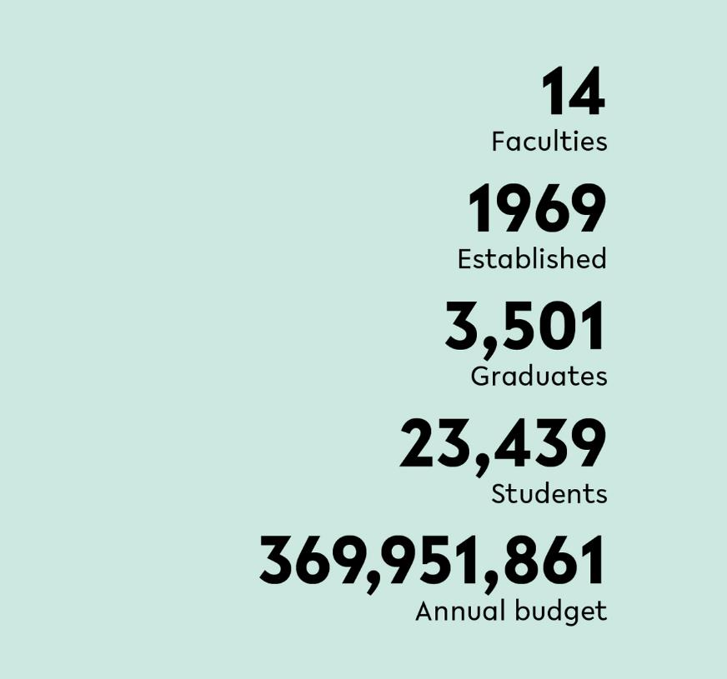
Bielefeld University in numbers
As a university internationally regarded for its top-level research and innovative teaching concepts, Bielefeld University makes a significant contribution to a progressive and participatory knowledge society. It is an attractive, family-friendly place to work and study and is characterised by an open communication culture, lived interdisciplinarity, diversity and freedom for personal development.
Bielefeld University was founded in 1969 with an explicit research
assignment and a mission to provide high-quality research-oriented
teaching. Today, the university serves some 23,000 students and encompasses 14 faculties – ranging from the humanities, natural sciences, and social sciences to technology and medicine.

Slide 3
Who we are.

Slide 4

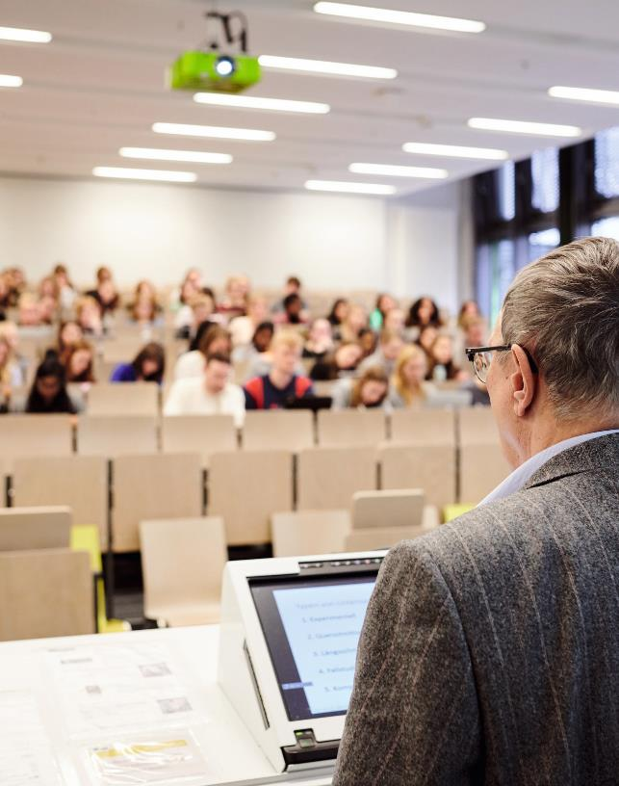
Studying at Bielefeld University
The university offers excellent study conditions and supports with comprehensive counseling services for study orientation and career choice. At the same time, it promotes personal responsibility for the success of one's studies as well as ambition and willingness to perform. Studying at Bielefeld University opens doors for young people in national and international job markets.

Slide 5
Faculties
■ Faculty of Biology
■ Faculty of Business Administration and Economics
■ Faculty of Chemistry
■ Faculty of Educational Science
■ Faculty of History, Philosophy and Theology
■ Faculty of Law
■ Faculty of Linguistics and Literary Studies
■ Faculty of Mathematics
■ Faculty of Physics
■ Faculty of Psychology and Sports
■ Faculty of Sociology
■ Faculty of Technology
■ Medical School OWL
■ School of Public Health
14
Number of faculties

Slide 6
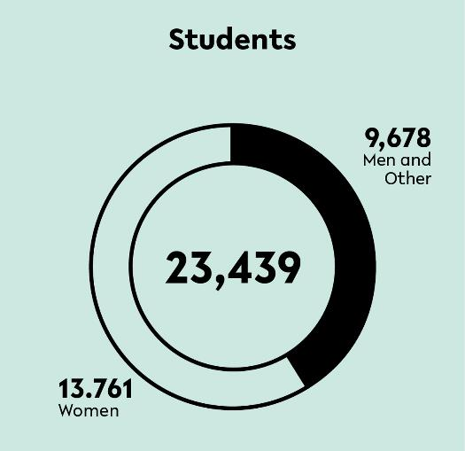
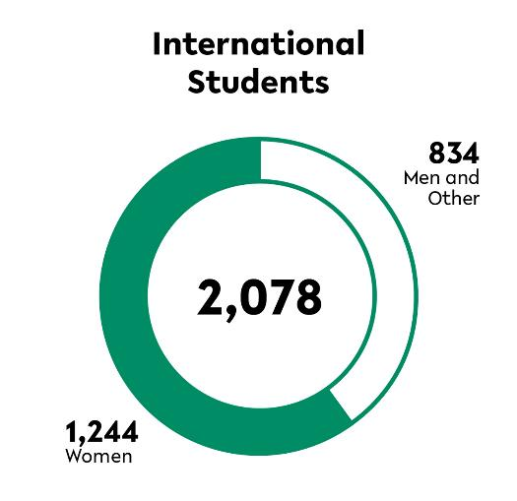
People at the University
Studying at Bielefeld University open doors to the national and international job markets. With a variety of subject combinations in the Bachelor’s degree programme, a wide-ranging catalogue of elective courses, and an interdisciplinary Master’s programme, students can move beyond the bounds of their chosen subject area.
Each year Bielefeld University welcomes several hundred visiting students from all over the world. A large number of cooperation programmes, courses in English and multilingual degree courses, Double Degree Programmes as well as study programmes with an international track prepare students and young researchers from Germany and abroad for the international job market.

Slide 7
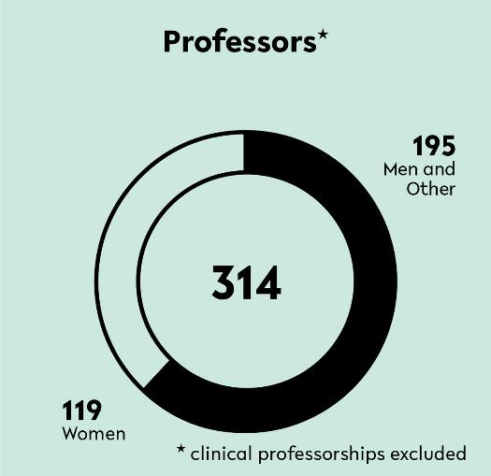
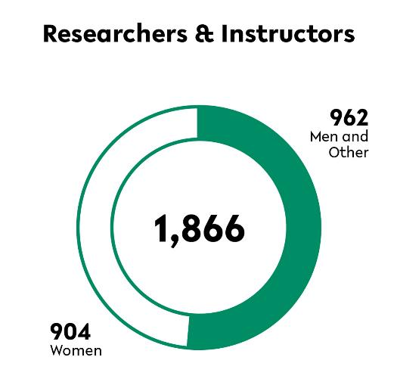
People at the University
Bielefeld University has steadily increased its proportion of female professors in recent years, but there is still a need for action. Therefore, the university uses a comprehensive portfolio of instruments to attract and retain more female professors.
A strong research university with a prominent international presence: Here, top-​class interdisciplinary research is carried out at the highest international level. Excellence in teaching means engaging students’ sense of personal responsibility. It also means taking each student seriously and treating them respectfully, irrespective of background, origin and interests, and acting in a fair and transparent manner.

Slide 8
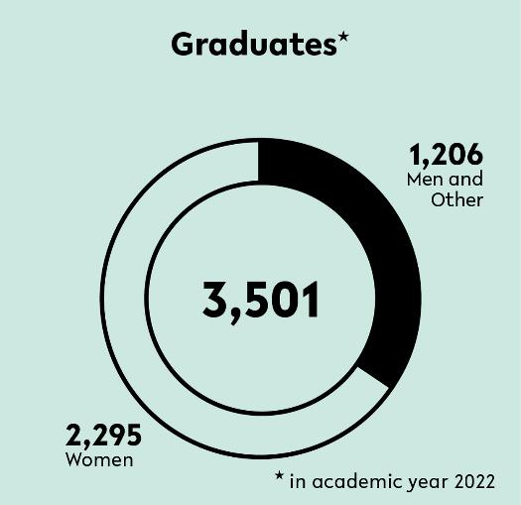
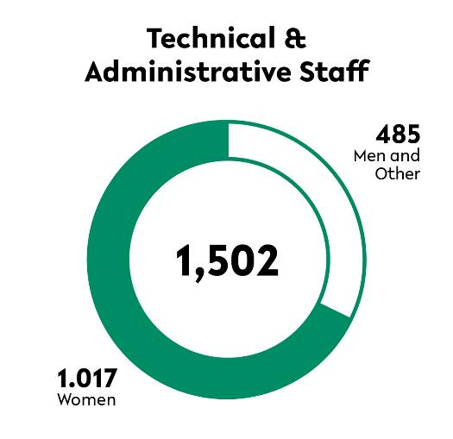
People at the University
Throughout their academic studies, students not only acquire specific specialist knowledge, but also the ability to think critically and analytically, to reflect upon and to solve problems. With this in mind, Bielefeld University attaches great importance to the teaching of civil courage, respect, willingness to take responsibility, and the ability to work together constructively.
The task and goal of the staff members in administration and services is to best support the researchers, instructors, and students of Bielefeld University. They provide services that are tailored to the needs of specific target groups.

Slide 9
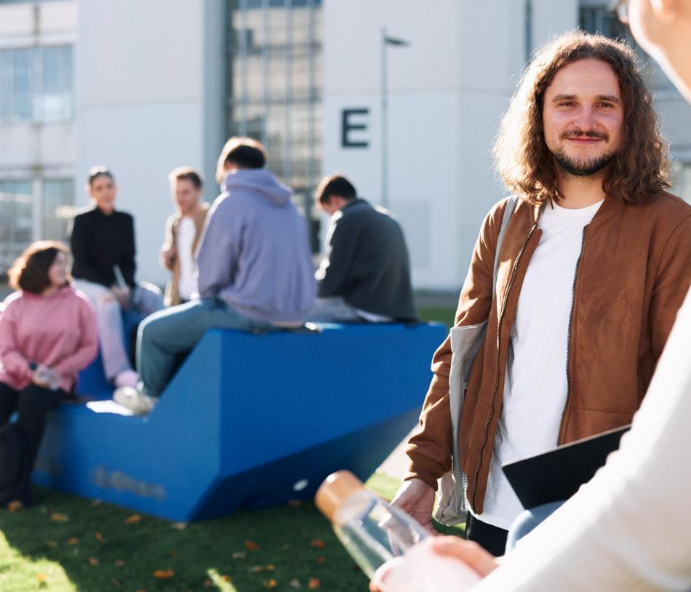
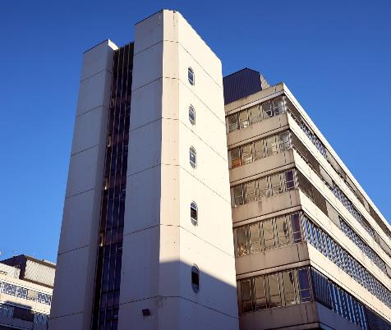



Slide 10

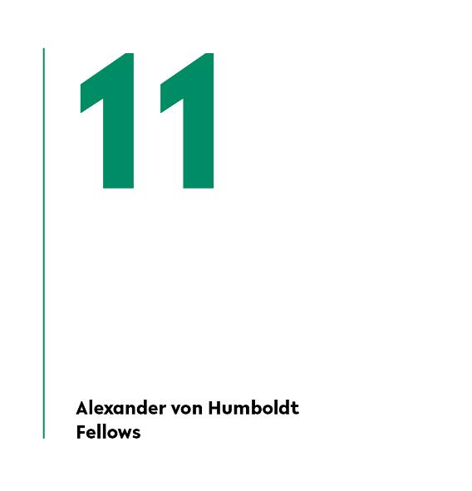
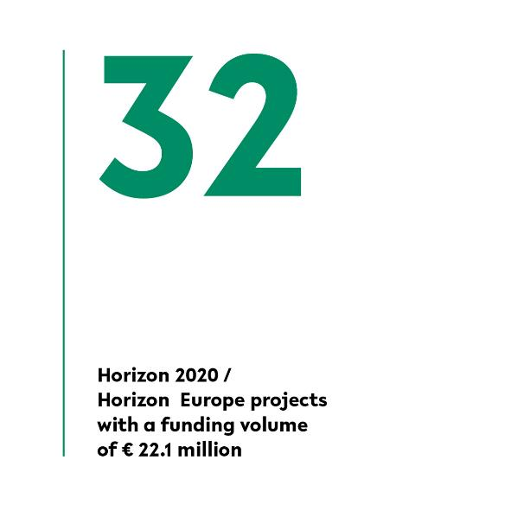
Internationality
Bielefeld University is an internationally renowned and globally networked institution.
It sees itself as a space for societal reflection, characterised by international exchange
and cultural openness.

Slide 11
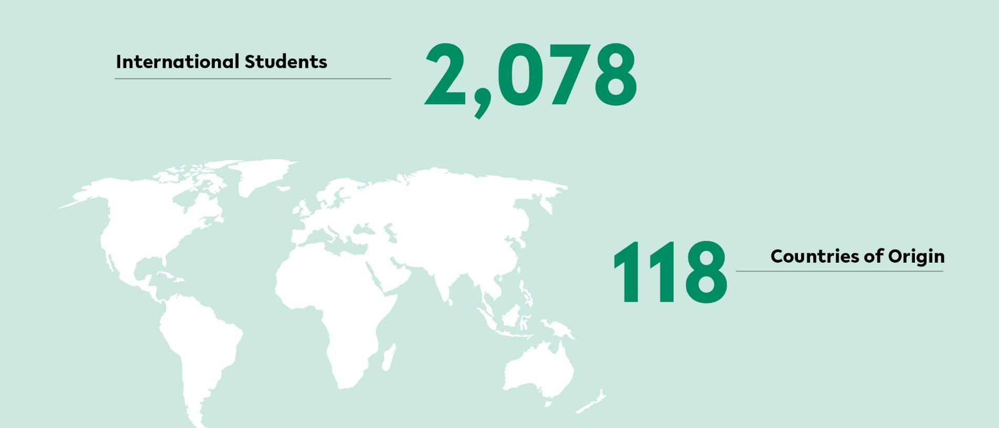

Slide 12


Funding
The diversity of externally funded research at Bielefeld University is reflected in the large number of funded research projects.
Currently, about 16 percent of the budget volume are externally funded projects.

Slide 13
What we do.

Slide 14

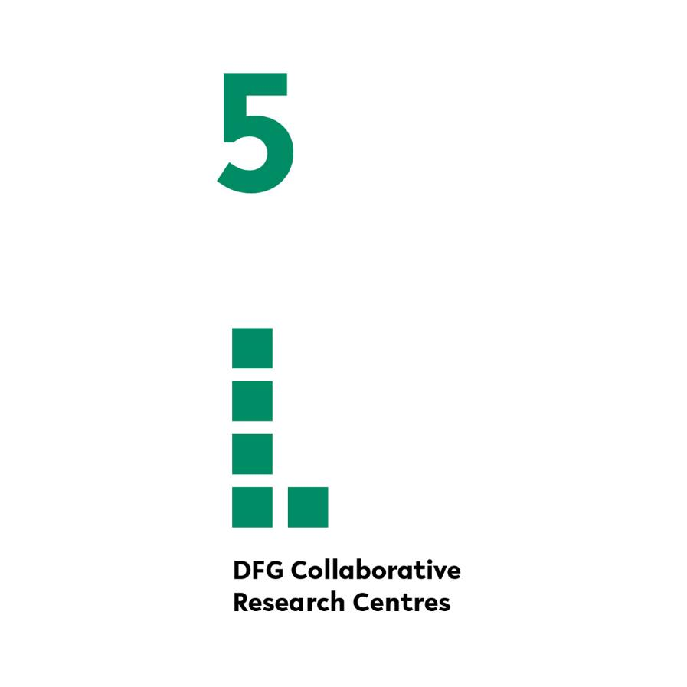
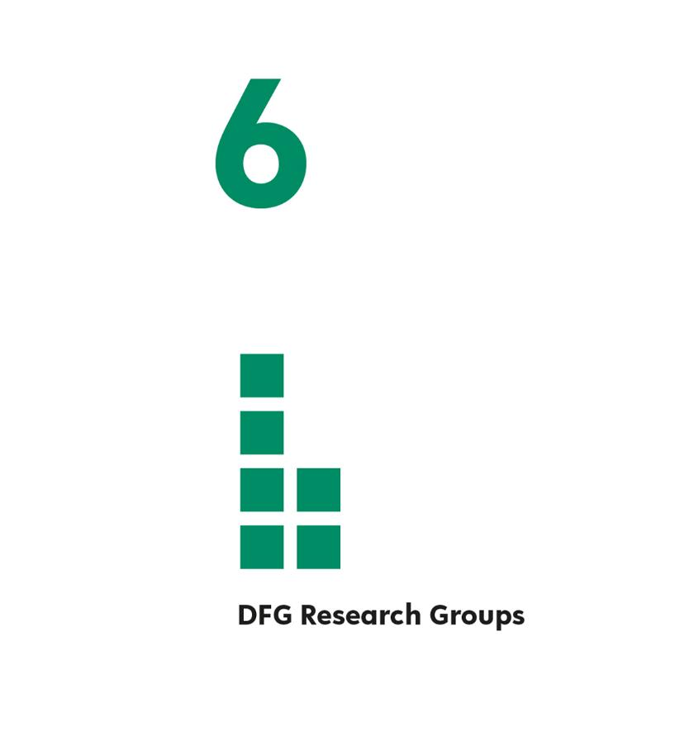
Research

Slide 15

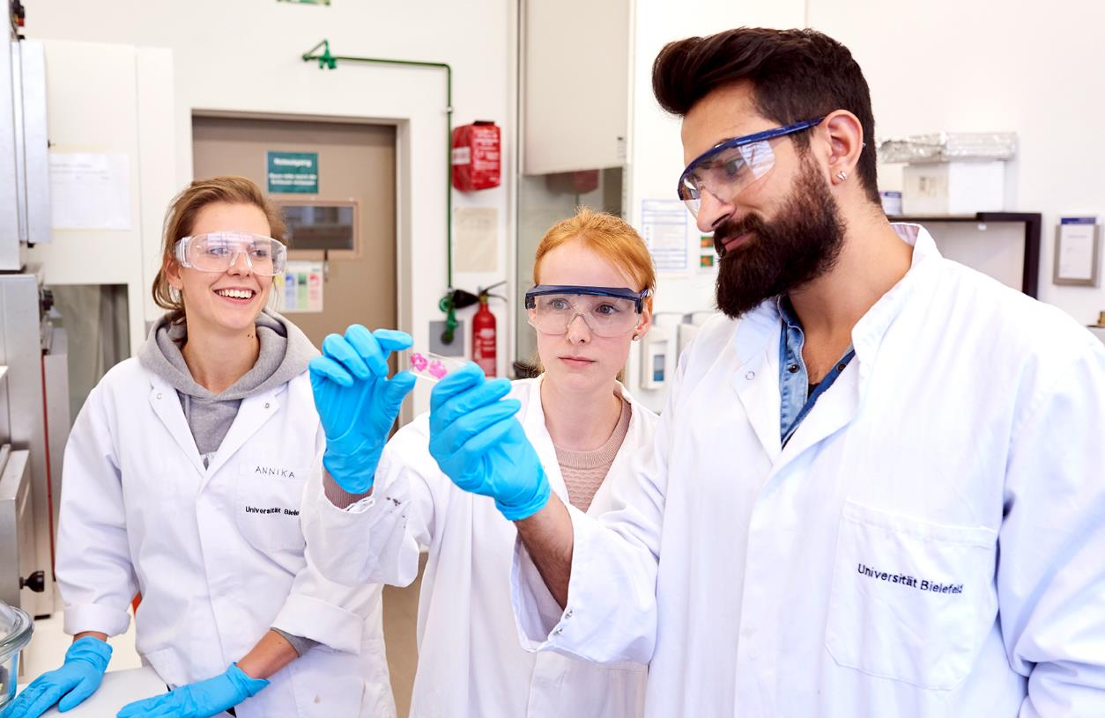
Research
Our researchers transcend borders – between disciplines, between people and between science and society. The principle of “transcending boundaries” is the driving force behind top-level basic research at the international level.

Slide 16
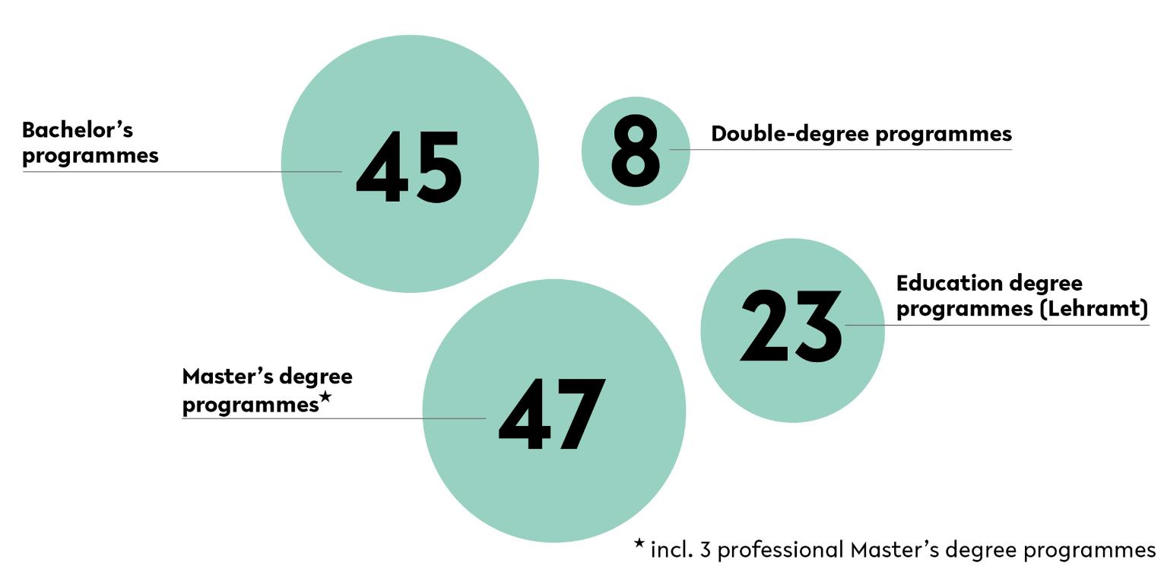
Fields of Study

Slide 17
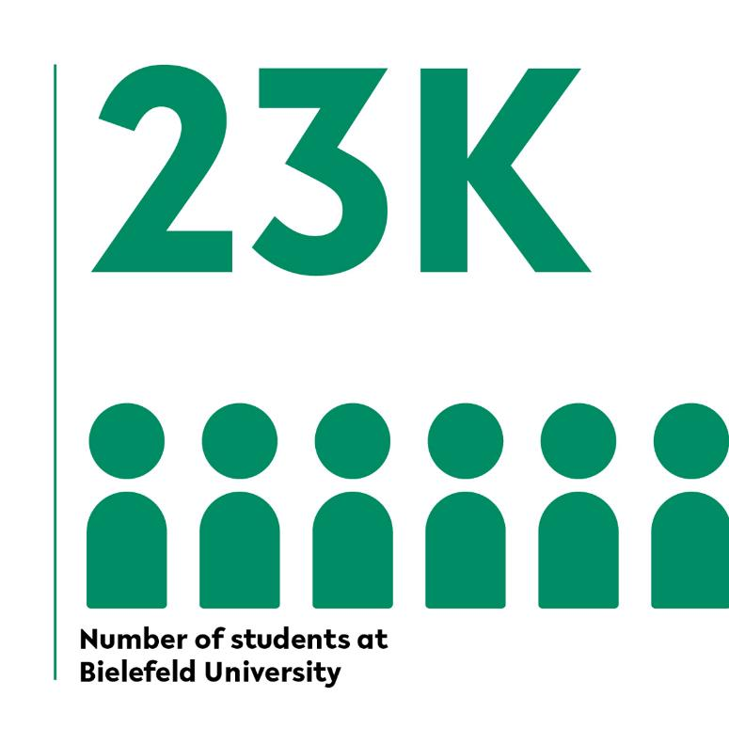
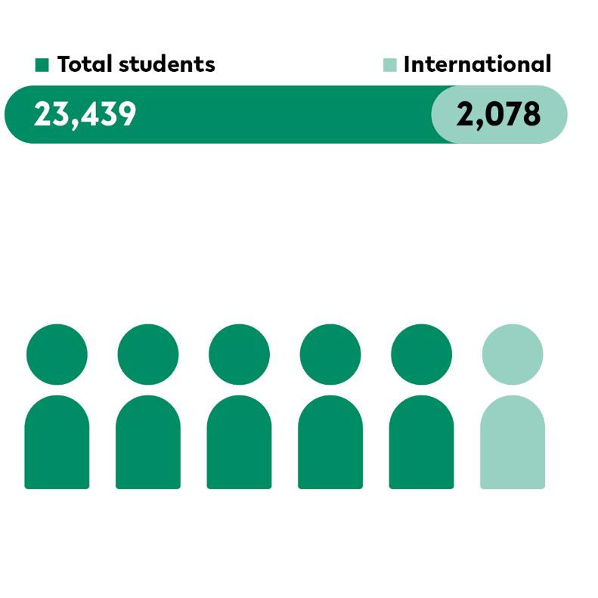
Students

Slide 18
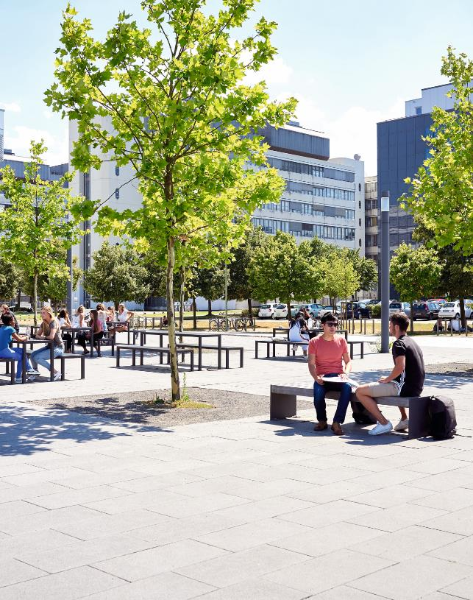
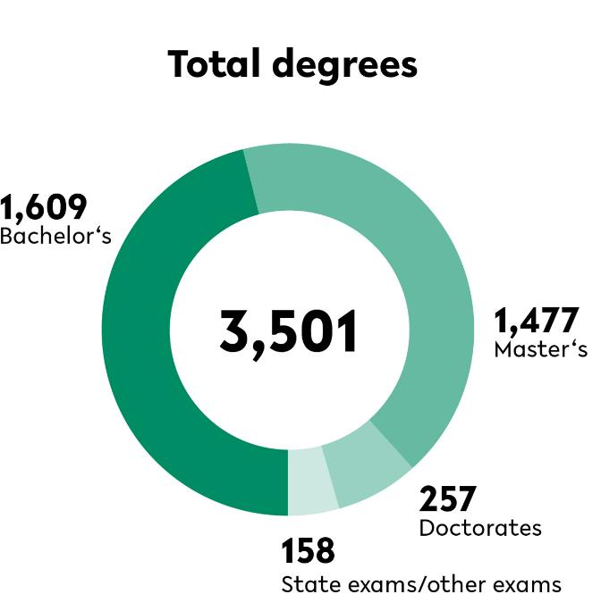
Students
The Bielefeld study model is characterised by a high degree of transparency and flexibility: With a large number of subject combinations and a uniform module system at the Bachelor’s level, a wide-ranging catalogue of elective courses, and interdisciplinary Master’s degree programmes, Bielefeld University actively promotes interdisciplinary teaching and learning.

Slide 19
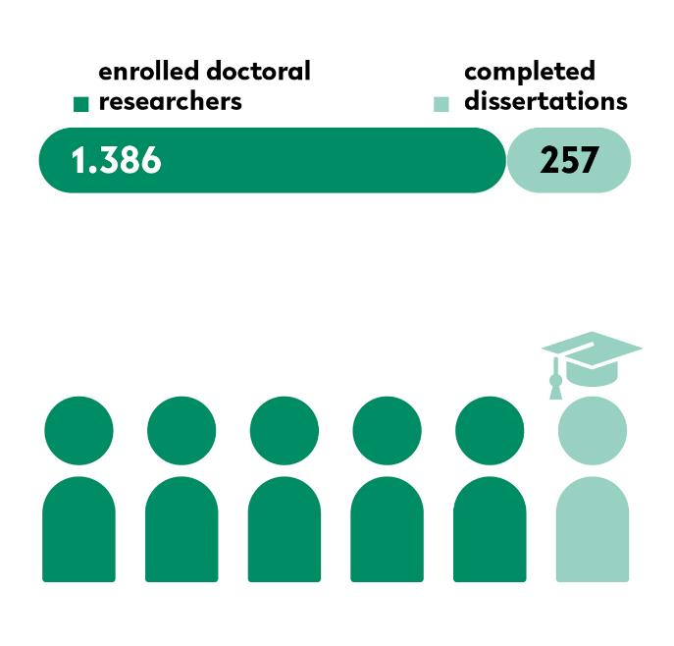
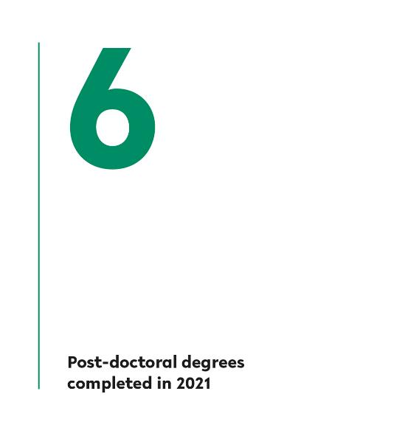
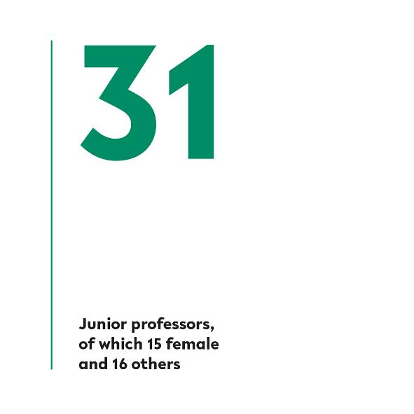
Young Researchers
Bielefeld University is the springboard for successful professional and personal biographies. We discover and support outstanding researchers,
appoint them to their first professorship and offer them long-term perspectives.

Slide 20
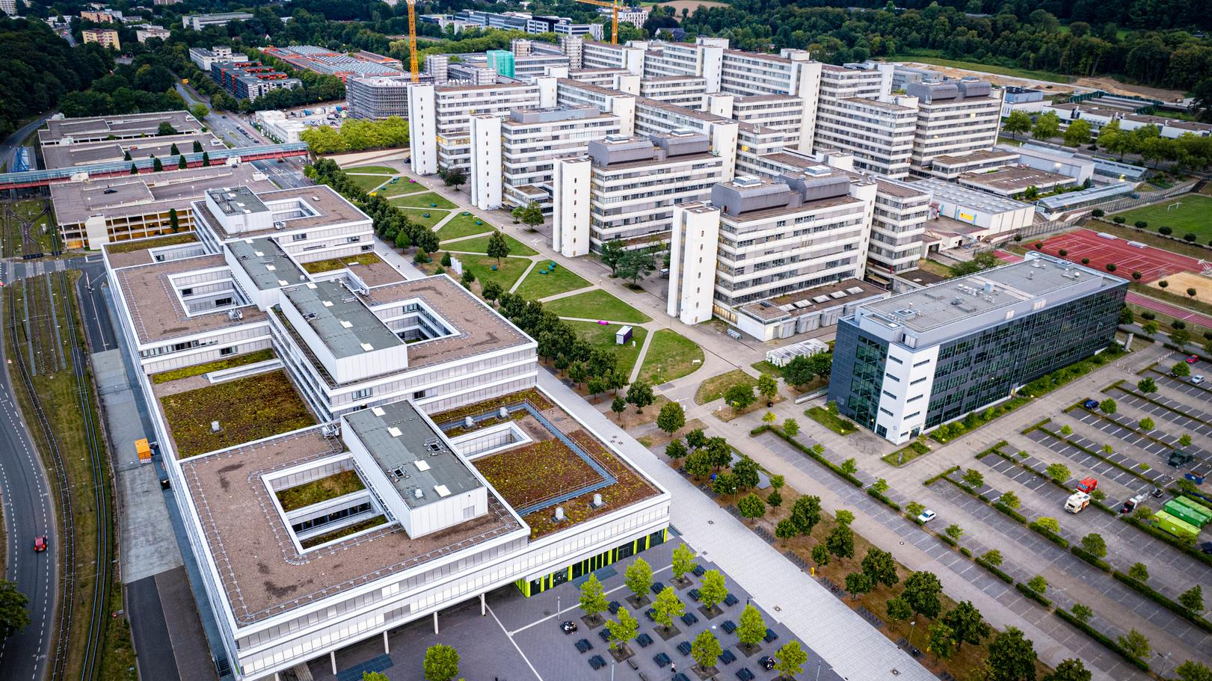

Slide 21
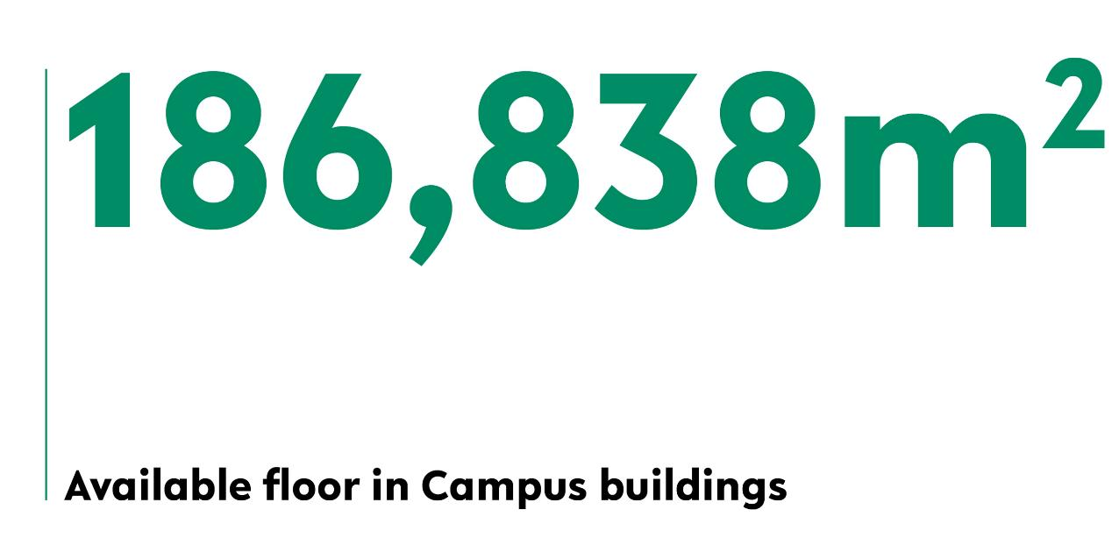

Campus
Bielefeld is growing as a center of science and research. New, state-of-the-art teaching and research facilities, the modernization of the Main University Building and new construction, together with the founding of the OWL Medical Faculty, set the stage for excellence in research,
teaching, and studying.

Slide 22
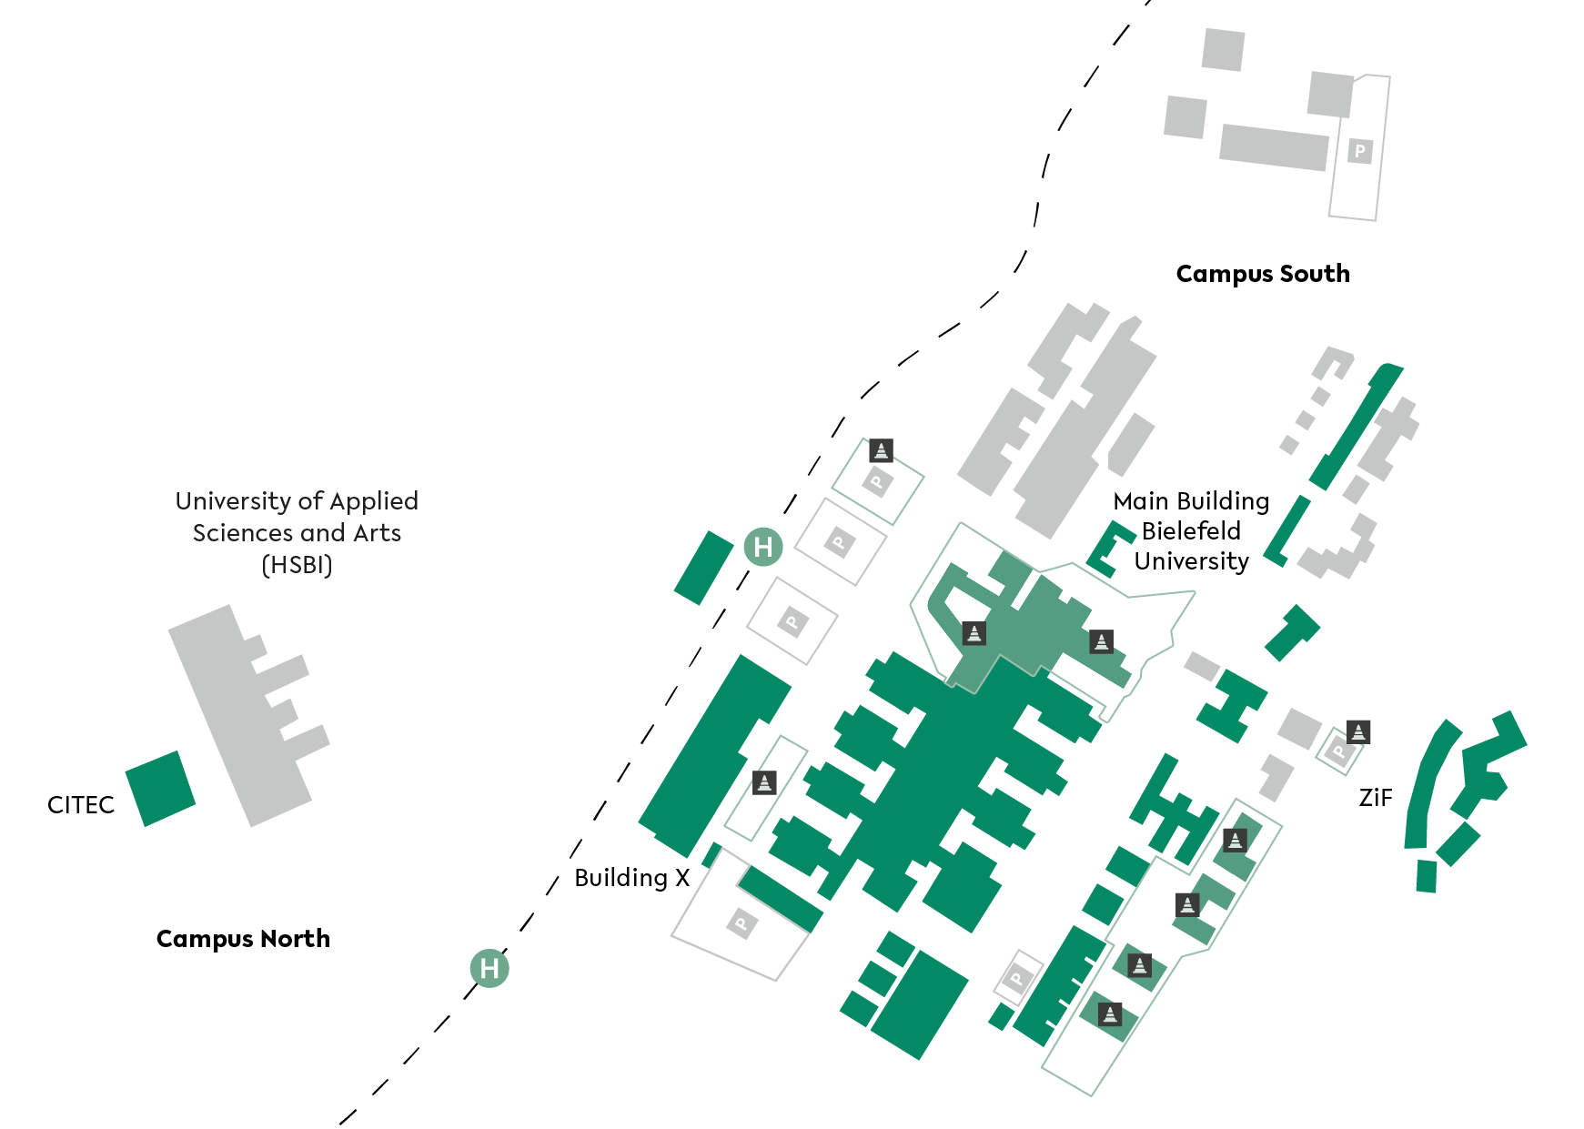
Bielefeld University Campus

Slide 23
Contact
Bielefeld University
Communication Office
Universitätsstraße 25
33615 Bielefeld
Germany
refkom@uni-bielefeld.de
Responsible in terms of press law:
Communication Office
2024 © Bielefeld University
uni-bielefeld.de
Data status: reporting date 31/12/2023

